Slide 1
Project :Customer Retention Case Study
Presented by : Rohan V Borade

Slide 2
Topics
Overview.
Problem Statement.
Problem Understanding.
Exploratory data analysis.
Visualizations.
Analysis.

Slide 3
Overview
In this particular presentation we will be looking on:
What are the EDA steps in cleaning the dataset.
Overall analysis on the problem.

Slide 4
Problem Statement:
Customer satisfaction has emerged as one of the most important factors that guarantee the success of online store;
it has been posited as a key stimulant of purchase, repurchase intentions and customer loyalty.
A comprehensive review of the literature, theories and models have been carried out to propose the models for customer activation and customer retention.
Five major factors that contributed to the success of an e-commerce store have been identified as: service quality, system quality, information quality, trust and net benefit.
The research furthermore investigated the factors that influence the online customers repeat purchase intention.
The combination of both utilitarian value and hedonistic values are needed to affect the repeat purchase intention (loyalty) positively.
The data is collected from the Indian online shoppers. Results indicate the e-retail success factors, which are very much critical for customer satisfaction.

Slide 5
Problem Understanding:
Customers are the are king of any kind of business.so to deal with them multiple sites study the purchase and sales pattern of the various other contemporary site, to get popular in the market.
There various other feature involved in this case study to predict the activation and retention of the customers.
Here I would like put light on some of them, which are as follows:
Customers retention are majorly depended on the various features, which we need to understand.
Some features are from the case study the product quality, better offers displayed by contemporary site, loyalty for the specific brands.
And more features are also used for analysis After first visit how do you reached online store , What is the preferred payment option, securely maintaining the private data of customer like bank details etc are the important features to be analysis by the site to make a remarkable move into the market.

Slide 6
What is customer retention ?
The customer retention definition in marketing is the process of engaging existing customers to continue buying products or services from your business. It’s different from customer acquisition or led generation because you’ve already converted the customer at least once.
The best customer retention tactics enable you to form lasting relationships with consumers who will become loyal to your brand. They might even spread the word within their own circles of influence, which can turn them into brand ambassadors.
You might have heard that it’s easier and less expensive to retain customers than to acquire them. The most recent statistics indicate that it’s true.
For one thing, you’ll spend five times less money on customer retention. Existing customers also spend 31 percent more than new leads, and when you release a new product, your loyal customers are 50 percent more likely to give it a shot.
The formula to calculate the customer retention is as follow :
No of customer at the end of the period - No of customer acquired during period/ No of customer at start of period * 100

Slide 7
Exploratory Data Analysis (EDA):
I have started the EDA by seeing the null values in the dataset there were no null values present in the dataset
I also checked data if it has any special character in it there was none.
Then I started visualizing the data using the heatmap to check if there is any null value or not.
Then I have used the seaborn library count plot to get insights of the data. Using group by method to more insights of the data set.
To get more insights I have converted the string data into the numerical by the help of label encoding.
And used histogram to get the insights , Also used dist- plot see the distribution of the dataset and identify skewness in data or not.
The data is skewed and not normally distributed we have to handle is with z score and standardization method to reduce the skewness.

Slide 8
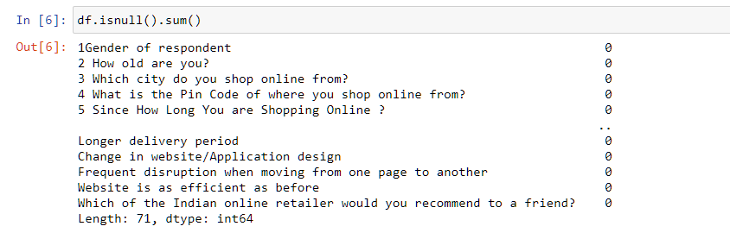
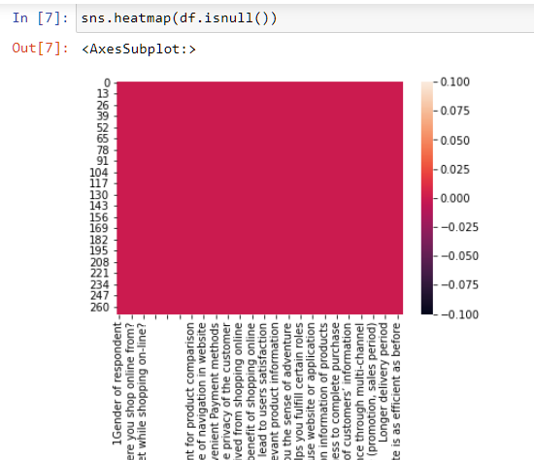
VISUALIZATION (CHECKING NULL VALUES)

Slide 9
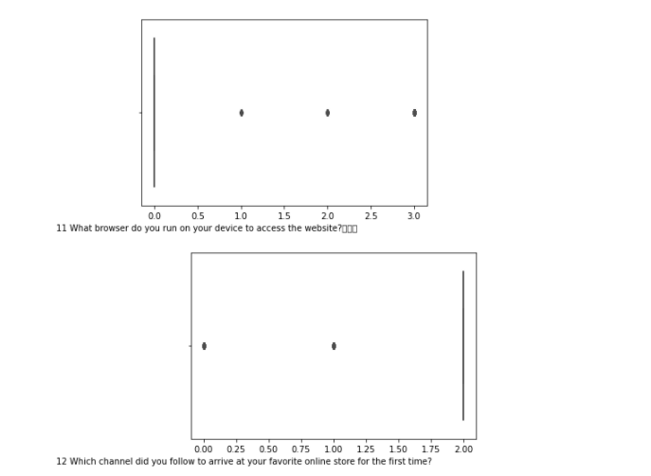

VISULIZATION (BOX PLOT)
Plotting the outliers using boxplot.

Slide 10
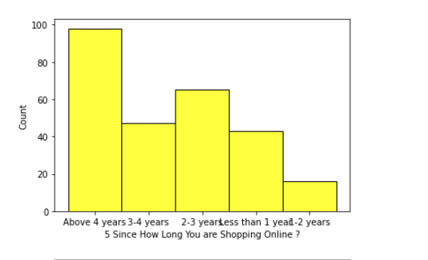
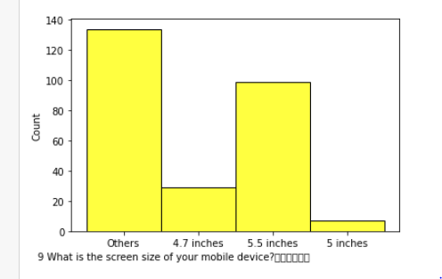
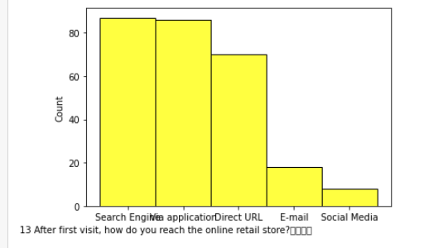
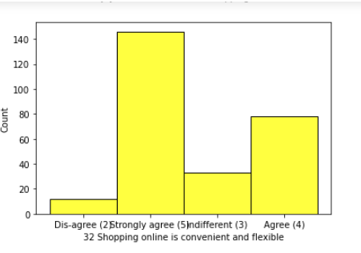
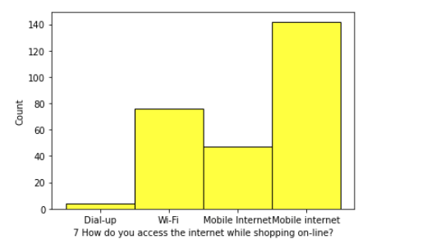
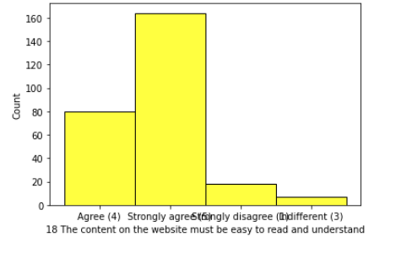
VISULIZATION (CHECKING SKEWENESS)
I will check how much skewness data contains.
Visualize through Histogram plot.

Slide 11
Conclusion:
The GUI also play important role to grab attention of the users. The graphical user interface, which leads to attract the customer by the visual effective given to the sites. Security of the financial information is most important task to the user data which contains secured information of the customer, so it also should be maintained by the sites
On average, acquiring a new client costs five times as much as keeping an existing one, and marketing to a new customer can cost five times as much as retaining an existing one, depending on the industry. Increasing client retention rates by merely 5%, on the other hand, can increase earnings by 25% to 95%.Customers who have already purchased from you are more likely than the average consumer to spend more, buy more, and promote your company to others.Here are effective customer retention strategies key to your business’s success.
Consumers enjoy being rewarded for their purchases. As a result, when you offer your customers exclusive discounts or promotions, they will feel both excited and valued.You can offer your clients random rewards to keep them happy.
When you try to build a brand, you’re attempting to instill a belief in your customers that will stay. That involves following through on the promises you make, as well as the ones you suggest.Keeping your promises builds loyalty.
Customer retention is the difference between firms that grow and those that don’t. The more clients you can retain and sell to, the more likely you are to meet your business objectives.The above customer retention techniques will allow you to deliver and extract additional value from your current client.

Slide 12
Thank you

